Slide 1
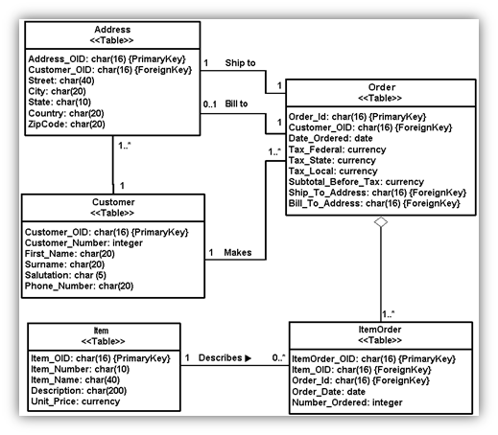
Physical Data Modelling

Slide 2
OLAP
OLAP (for online analytical processing) is software for performing multidimensional analysis at high speeds on large volumes of data from a data warehouse, data mart, or some other unified, centralized data store.

Slide 3
OLAP
OLAP (online analytical processing) is a computing method that enables users to easily and selectively extract and query data in order to analyze it from different points of view. OLAP business intelligence queries often aid in trends analysis, financial reporting, sales forecasting, budgeting and other planning purposes.

Slide 4
For Example
A user can request that data be analyzed to display a spreadsheet showing all of a company's beach ball products sold in Florida in the month of July, compare revenue figures with those for the same products in September and then see a comparison of other product sales in Florida in the same time period.

Slide 5
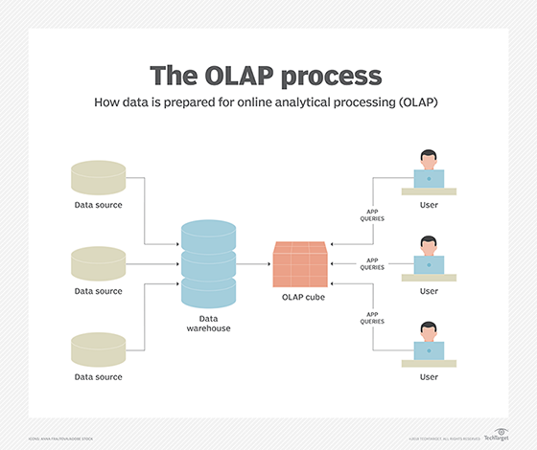

Slide 6
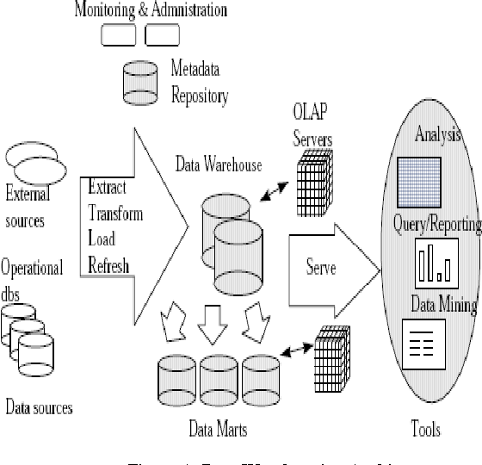

Slide 7
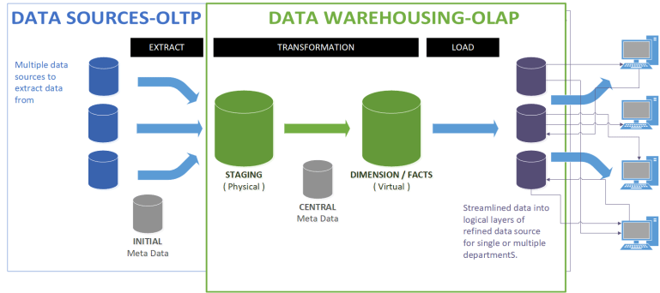

Slide 8
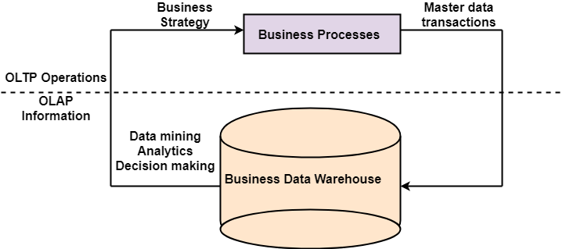

Slide 9
OLAP Operations
Since OLAP servers are based on multidimensional view of data, we will discuss OLAP operations in multidimensional data.
Here is the list of OLAP operations −
Roll-up
Drill-down
Slice and dice
Pivot (rotate)

Slide 10
1. Roll-up
Roll-up performs aggregation on a data cube in any of the following ways −
By climbing up a concept hierarchy for a dimension
By dimension reduction

Slide 11
2. Drill-down
Drill-down is the reverse operation of roll-up. It is performed by either of the following ways −
By stepping down a concept hierarchy for a dimension
By introducing a new dimension.

Slide 12
3. Slice
The slice operation selects one particular dimension from a given cube and provides a new sub-cube. Consider the following diagram that shows how slice works.
Dice
Dice selects two or more dimensions from a given cube and provides a new sub-cube. Consider the following diagram that shows the dice operation.

Slide 13
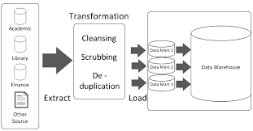
Bottom up Approach

Slide 14
Roll-up and Drill-down
The roll-up operation performs aggregation on a data cube, either by climbing up a concept hierarchy for a dimension or by dimension reduction such that one or more dimensions are removed from the given cube.
Drill-down is the reverse of roll-up. It navigates from less detailed data to more detailed data. Drill-down can be realized by either stepping down a concept hierarchy for a dimension or introducing additional dimensions.

Slide 15
Graphical Description of Roll up
Roll-up
on Store Dimension
(from store to area)
Store is the child of Area

Slide 18
Slice and dice
The slice operation performs a selection on one dimension of the given cube, resulting in a sub_cube.
The dice operation defines a sub_cube by performing a selection on two or more dimensions.

Slide 19
Graphical Description of Slice
Slice
WHERE store = ‘292’

Slide 21
Graphical Description of Dice
Dice
WHERE (store = ‘292’) and (time = ‘Dec’) and product = ‘ALL’

Slide 22
Sr. No. | Category | OLAP (Online analytical processing) | OLTP (Online transaction processing)
1. | Definition | It is well-known as an online database query management system. | It is well-known as an online database modifying system.
2. | Data source | Consists of historical data from various Databases. | Consists of only of operational current data.
3. | Method used | It makes use of a data warehouse. | It makes use of a standard database management system (DBMS).
4. | Application | It is subject-oriented. Used for Data Mining, Analytics, Decisions making, etc. | It is application-oriented. Used for business tasks.
5. | Normalized | In an OLAP database, tables are not normalized. | In an OLTP database, tables are normalized (3NF).
6. | Usage of data | The data is used in planning, problem-solving, and decision-making. | The data is used to perform day-to-day fundamental operations.

Slide 23
7. | Task | It reveals a snapshot of present business tasks. | It provides a multi-dimensional view of different business tasks.
8. | Purpose | It serves the purpose to extract information for analysis and decision-making. | It serves the purpose to Insert, Update, and Delete information from the database.
9. | Volume of data | A large amount of data is stored typically in TB, PB | The size of the data is relatively small as the historical data is archived. For ex MB, GB
10. | Queries | Relatively slow as the amount of data involved is large. Queries may take hours. | Very Fast as the queries operate on 5% of the data.
11. | Update | The OLAP database is not often updated. As a result, data integrity is unaffected. | The data integrity constraint must be maintained in an OLTP database.

Slide 24
12. | Backup and Recovery | It only need backup from time to time as compared to OLTP. | Backup and recovery process is maintained rigorously
13. | Processing time | The processing of complex queries can take a lengthy time. | It is comparatively fast in processing because of simple and straightforward queries.
14. | Types of users | This data is generally managed by CEO, MD, GM. | This data is managed by clerks, managers.
15. | Operations | Only read and rarely write operation. | Both read and write operations.
16. | Updates | With lengthy, scheduled batch operations, data is refreshed on a regular basis. | The user initiates data updates, which are brief and quick.
17. | Nature of audience | Process that is focused on the customer. | Process that is focused on the market.

